Slide 1


Case Study Roni Asatourian

Slide 2
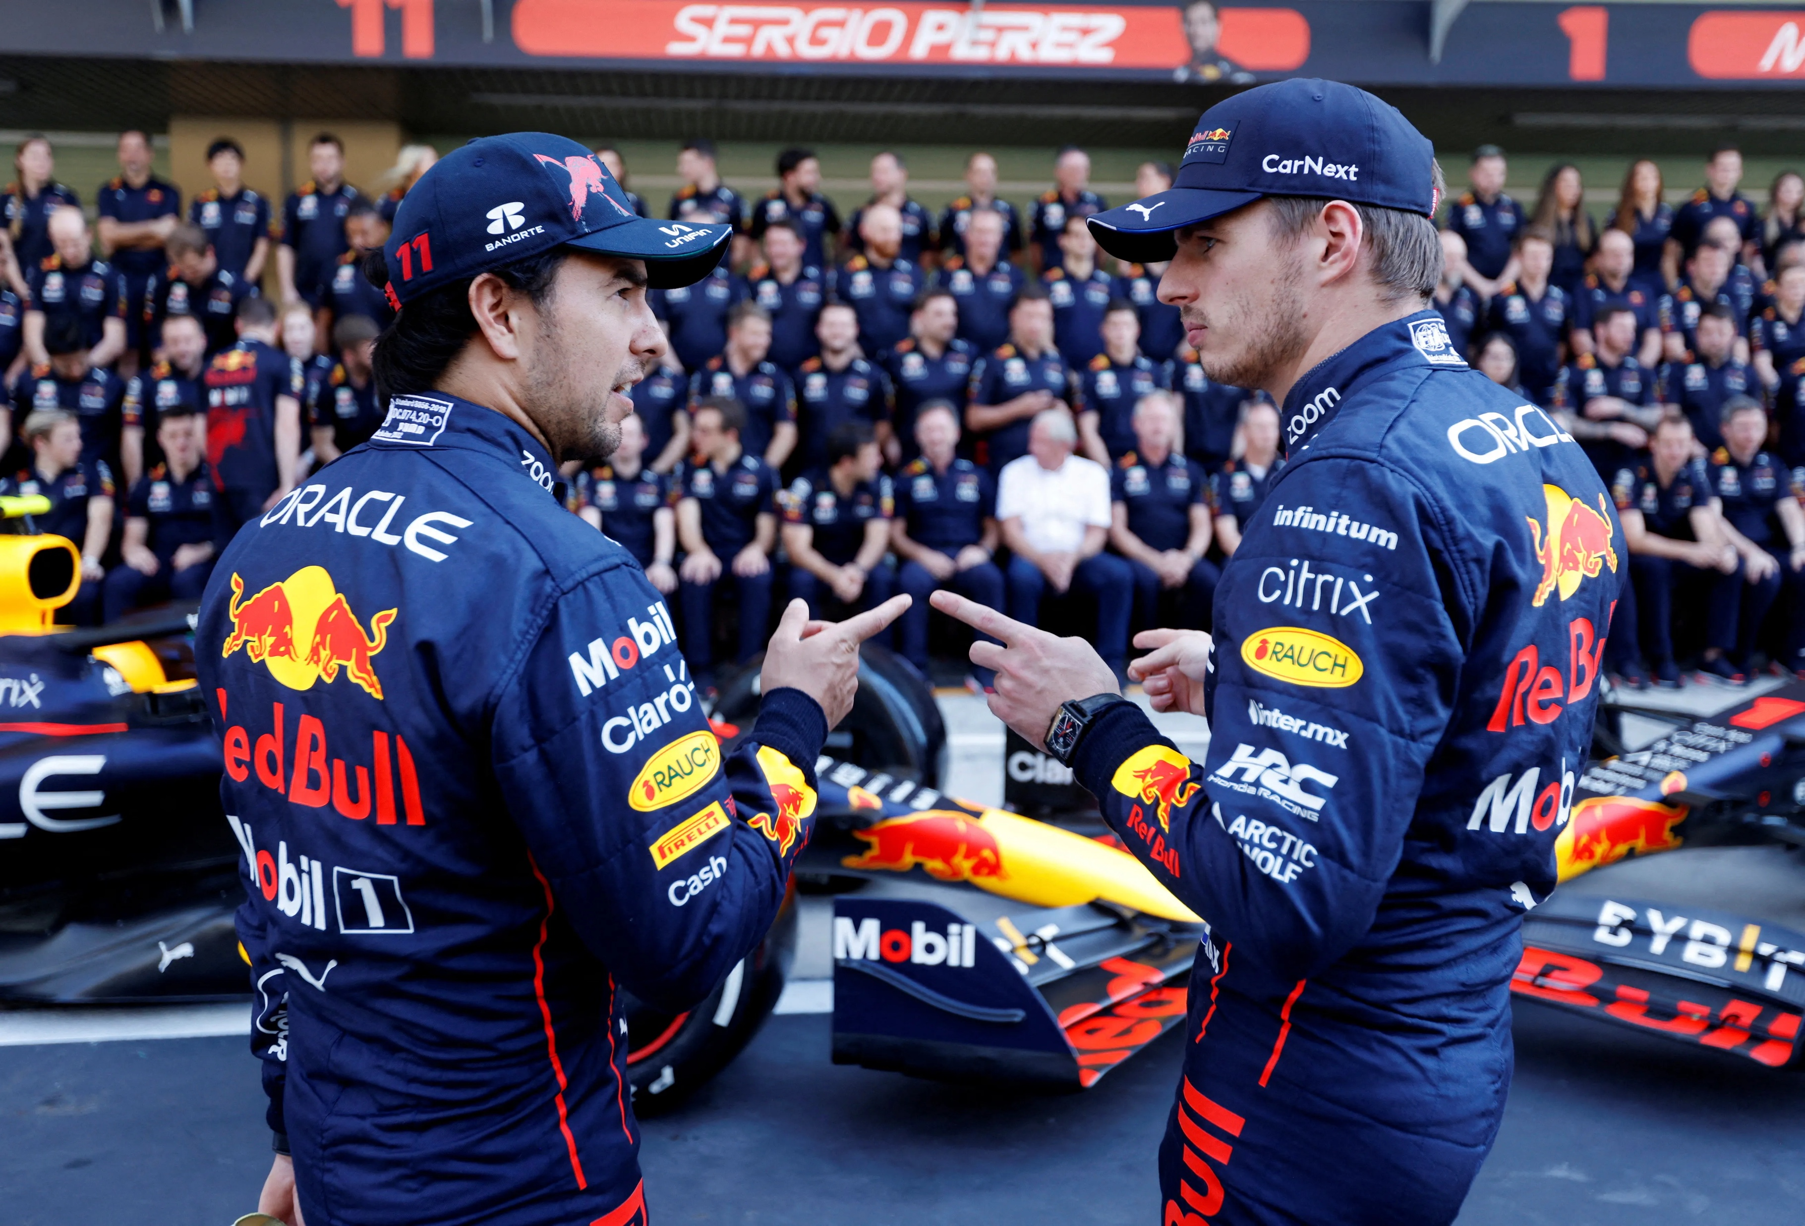
Introduction to Data Analysis for Red Bull F1:
Utilizing Data in Formula 1 Racing
Purpose: Boosting Team and Driver Performance
through the power of Data Analysis
Analysis Approach: EDA, Regression, Forecasting
Expected Outcomes: Informed Decisions &
Enhanced Performance
Presentation Structure: From Data Exploration
to Strategic Insight

Slide 3
Data Architecture & tooling
Data Sources: Daily CSV Files
Data Processing: Python, Airflow
Data Warehousing: Google BigQuery
Visualization & Reporting: Tableau Dashboard
Data Model: Star Schema for Optimized Query performance
Fact Table: Race Performance Metrics
Dimension Tables: Driver, Team, Race Event, Venue, Season
Next Page for the Overall Overview

Slide 4
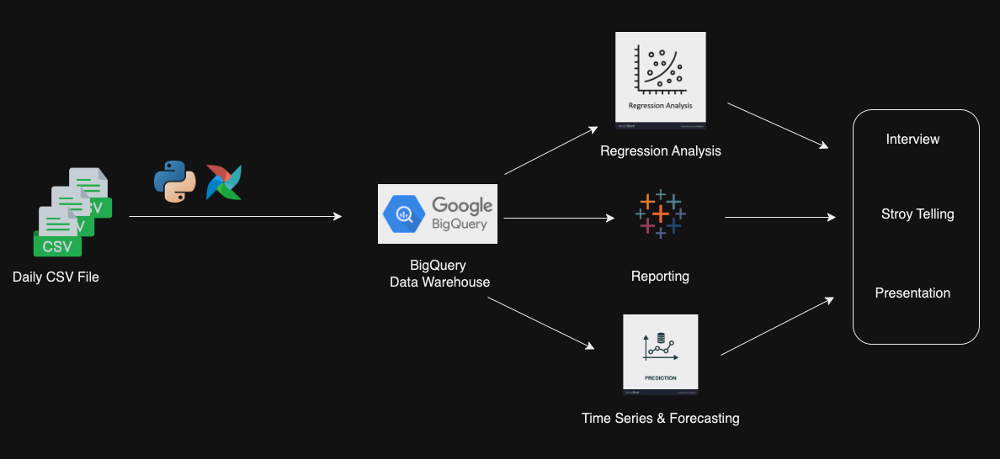
Data Architecture & tooling

Slide 5
Key Findings from Exploratory Data Analysis:

Slide 6
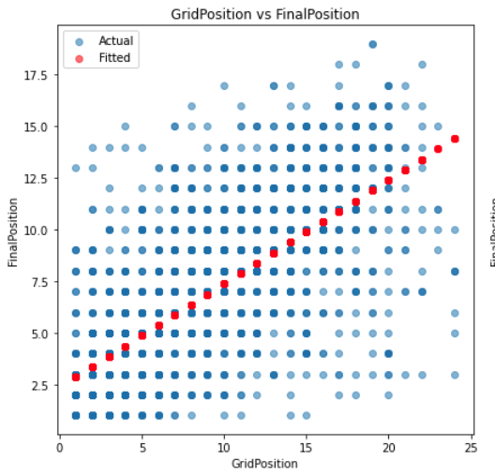
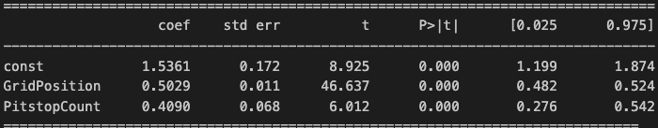
Regression Analysis and significant variables:
Model Overview: Utilized Ordinary Least Squares (OLS) regression to identify determinants of race final positions.
R-squared Value: At 0.492, nearly 50% of the variability in final race positions can be explained by our model.
Significant Predictors:
Grid Position: Starting closer to the front significantly increases the chances of a better final position (p < 0.001).
Pit Stop Count: Fewer pit stops are associated with better final positions, highlighting the importance of race strategy and efficiency (p < 0.001).
Strategic Implications:
Qualifying Performance: Importance of qualifying rounds in securing a favorable starting grid position.
Pit Stop Strategy: Optimizing pit stop strategy to minimize time lost.
Recommendations for Improvement:
Invest in qualifying performance analytics and training.
Develop predictive models for optimal pit stop timing.
FinalPostion = 1.53 + (0.5 x GridPosition) + (0.4 x PitstopCount)

Slide 7
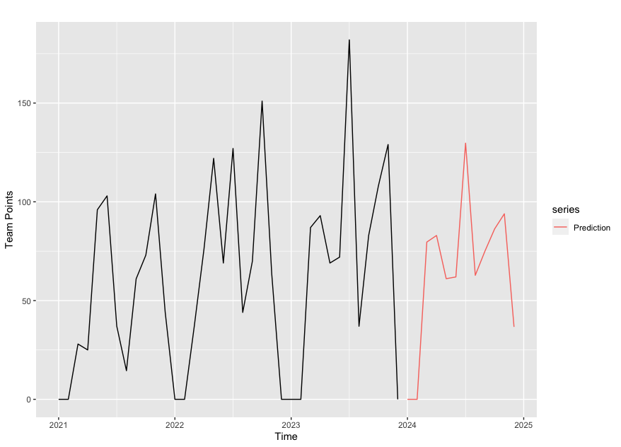
Forecasting 2024 Season trends:
Continued Excellence: Forecast suggests Red Bull's F1 team is going to maintain its strong performance, building on its successful history.
Dominance in the Sport: The data points to Red Bull's continued prominence in the league, with a potential to outperform competitors.
Informed Strategy: Use of predictive analytics for planning resource allocation, driver training, and car development throughout the season.
Jan | Feb | Mar | Apr | May | Jun | Jul | Aug | Sep | Oct | Nov | Dec
0.0 | 0.0 | 79.6 | 82.9 | 61 | 61.9 | 129.7 | 62.7 | 75 | 86.2 | 86.2 | 36.6
Predicted Season Total Points: 770

Slide 8
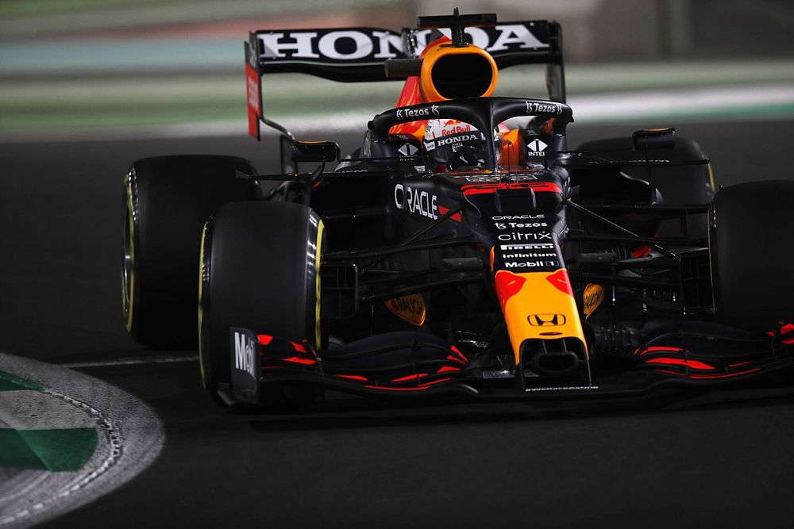




Business Insights and Recommendations:
Optimization of Pit Stop Strategies:
Analyze historical pit stop data to optimize timing and frequency.
Recommend strategies to minimize time lost during pit stops.
Driver Performance Analysis:
Compare the performance of Red Bull drivers with competitors using advanced metrics.
Provide insights on areas for improvement in driver skills and strategies.
Risk Management in Uncertain Conditions:
Develop models to manage risks in uncertain race conditions (like weather changes).
Provide strategies for quick decision-making during unexpected scenarios.
Injury Prevention and Health Monitoring:
Implement data-driven approaches for monitoring driver health and fitness.
Suggest preventive measures to reduce the risk of injuries.
Enhancing Sponsorship and Marketing Efforts:
Analyze fan engagement data to improve marketing strategies.
Develop forecasting models to predict season outcomes to attract and negotiate with sponsors

Slide 9
Thank you
Project Link: Red-bull-F1-Case

